Slide 1
EIT x Soft Robots: project update
Week of Monday 30/08/2021

Slide 2
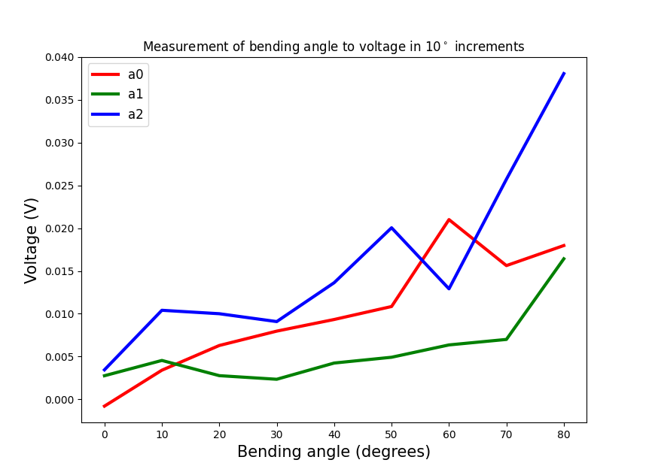
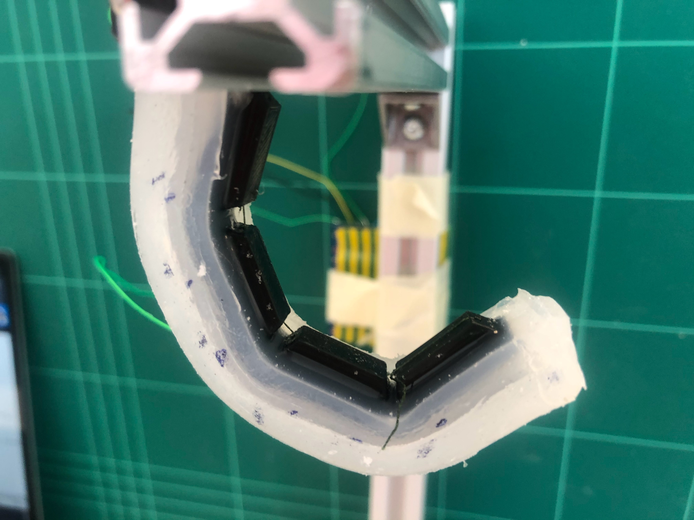
Copper wire actuator data – bending angle with voltage
a2
a1
a0

Slide 3
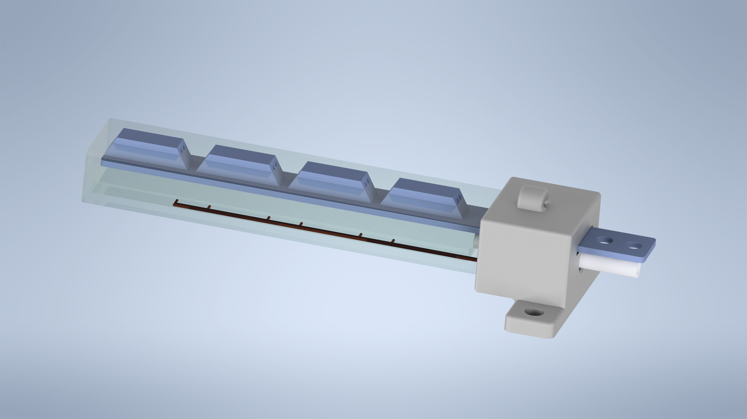
Thesis and presentation: creating images and writing writing writing
Render of finger CAD model

Slide 4
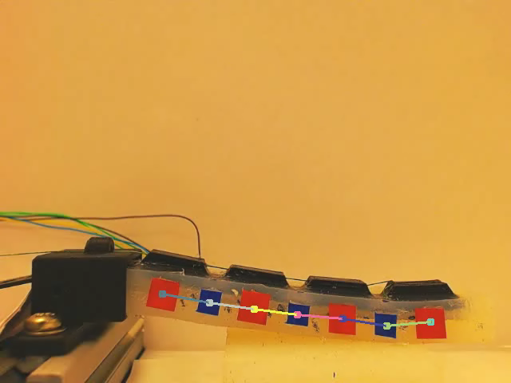
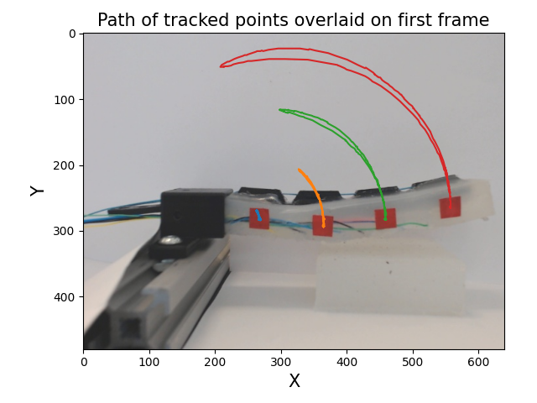
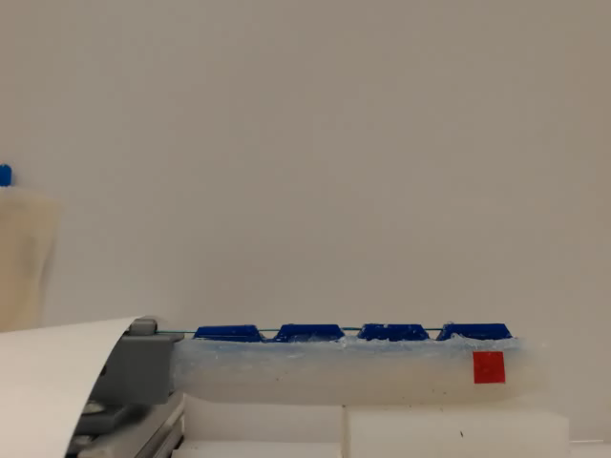
Computer vision progress
Units are pixels

Slide 5
TODO
Questions
Final presentation work!
Thesis writing
Repeat bending angle x voltage experiment for more precise results
Attempt simple ML experiment
Feedback on literature review?

